Slide 1
Basic SQL (Tool: MYSQL Workbench)

Slide 2
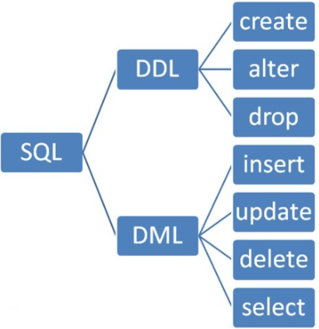
SQL Data Definition Langage Data Manipulation Language

Slide 3
Ddl (data definition language )
In databases, DDL (Data Definition Language) and DML (Data Manipulation Language) are two types of SQL commands, each serving a distinct purpose:
1. DDL (Data Definition Language)
DDL commands define or modify the structure of the database, including tables, indexes, and schema.
Examples of DDL Commands:
CREATE: Creates a new table, index, or database.
ALTER: Modifies an existing database object, like a table.
DROP: Deletes an entire table, database, or index.
TRUNCATE: Removes all rows from a table without deleting the table structure itself.
Purpose: Primarily for designing the structure of a database. Changes made with DDL are often automatically committed, meaning they cannot be rolled back.

Slide 4
2. DML (Data Manipulation Language)
DML commands are used to manipulate the data within database tables (insert, update, delete, retrieve).
Examples of DML Commands:
SELECT: Retrieves data from one or more tables.
INSERT: Adds new records into a table.
UPDATE: Modifies existing records in a table.
DELETE: Removes records from a table based on a condition.
Purpose: Primarily for managing and querying the data stored within the structure created by DDL commands. DML commands are typically part of transactions and can be rolled back if needed.

Slide 5
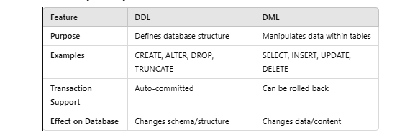
Key differences btw ddl and dml
In short, DDL is for defining the framework, and DML is for managing the data inside that framework.

Slide 6
Getting Started …
Before creating a table in the database, we need to create a database itself:
Create database databaseName;
Example:
Create database Company;
SQL is not case sensitive. (for queries doesn’t matter k capital likhou ya small but for better understanding of the code behtr hae k queries kou hum capital hi kr k likhein. )
Every command needs to end with a semicolon.

Slide 7
Main Commands for DDL
Using DDL commands we can make changes in the structure of the database.
In pae changes ki jaein ge..
1. table 2. database 3. index
Main Commands:
Create – used to create a new table in the database
Alter – used to make changes in the already created tables
Drop – used to delete an existing table

Slide 8
Getting Started …
We can delete a database :
Drop database DatabaseName;
Example:
Drop database Company;

Slide 9
Getting Started …
Before creating a new table or viewing already constructed tables we need to make sure we are in scope of the database or we are present in a database.
Use databaseName ;
Example:
Use Company;
We can see tables present in an existing database:
Example:
Show tables;

Slide 10
How to create a table Datatypes & Constraints

Slide 11
Datatypes
Numeric values
INT (Size: 4 Bytes)
NUMERIC(I, j) 888.88
Double(size , precision(number of digits after the decimal ) )
Fixed point number, with user-specified precision of p digits, with d digits to the right of decimal point
Character String
Fixed length: CHAR(5) CAT_ _
Non-fixed length: VARCHAR(n) CAT
Some more important datatypes
Boolean: TRUE, FALSE, NULL
DATE : yyyy-mm-dd
TIME: hh:mm:ss
TIMESTAMP: DATE(DD-MM-YYYY) & TIME (HH:MM:SS)
Automatic initialization and updating to the current date and time can be specified using DEFAULT CURRENT_TIMESTAMP and ON UPDATE CURRENT_TIMESTAMP in the column definition(read from w3school )
Notes:
NUMERIC must be exactly as precise as it is defined — so if you define 4 decimal places to the left of the decimal point and 4 decimal places to the right of it, the DB must always store 4 + 4 decimal places, no more, no less.
DECIMAL is free to allow higher numbers if that's easier to implement. This means that the database can actually store more digits than specified (due to the behind-the-scenes storage having space for extra digits). This means the database might allow storing 12345.0000 in the above example of 4 + 4 decimal places, but storing 1.00005 is still not allowed if doing so could affect any future calculations.

Slide 12
Key words for Constraints
NOT NULL – used for required fields
UNIQUE – used for attributes that cannot have a duplicate value (other than pk)
DEFAULT – used to assign some default value to an attribute
Default ‘ali’ ----- default 2; syntax for numbers and strings.
CHECK(Dnumber > 0 AND Dnumber < 21) -- used to set a condition on the input value for an attribute.
Primary key – used to make an attribute primary key of the table
Foreign Key (A) references s(B) -- used to make an attribute foreign key.

Slide 13
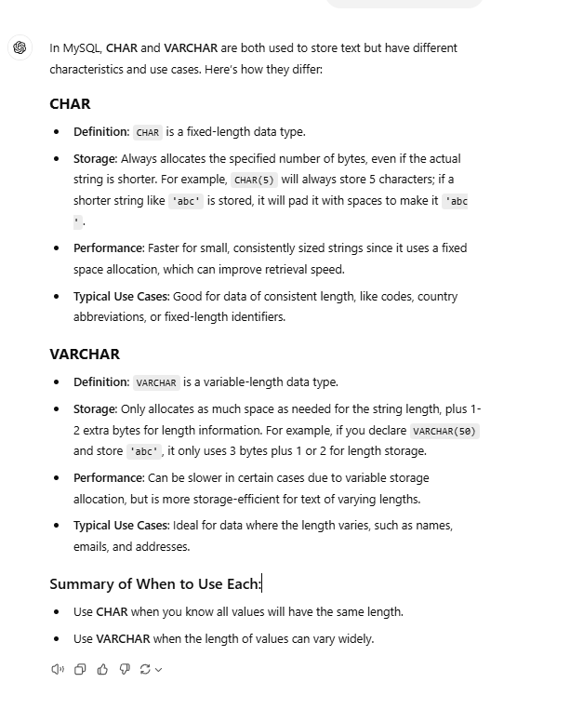

Slide 14
Create Table
CREATE TABLE tablename
(
AttributeName Datatype Constraint,
…....
);

Slide 15
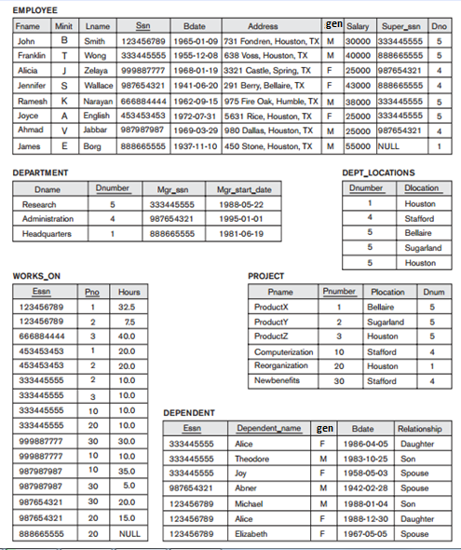
Employee(why cant we just write primary key and foreign key after the name of the attribute , what is the benefit of writing it up as an constraint) give syntax in chatgpt ) .
CREATE TABLE Employee
(
Fname,
Minit,
Lname,
Ssn,
Bdat,
Address,
Gender,
Salary,
Super_ssn ,
Dno ,
CONSTRAINT PK_Employee PRIMARY KEY (attributes),
CONSTRAINT FK_EmpDep FOREIGN KEY (attribute)
REFERENCES table name(attribute) );
For alter we have
Alter foreign key
But a relation can have more than one foreign key , for that case unkou apas mae distinguish krny k liye we use constraint to give names to the foreign key , takkey phir unkou future mae refer krna easy hou ;)…

Slide 16
Employee
CREATE TABLE Employee
(
Fname VARCHAR(15) NOT NULL,
Minit CHAR(1),
Lname VARCHAR(15) NOT NULL,
Ssn CHAR (9) NOT NULL,
Bdat DATE,
Address VARCHAR(30) DEFAULT 'UCP',
Gender Char(1),
Salary int,
Super_ssn CHAR(9),
Dno INT ,
Primary key (ssn),
CONSTRAINT FK_EmpDep FOREIGN KEY (Dno)
REFERENCES DEPARTMENT(Dnumber) );

Slide 17
Solution of Foreign key violation(explain)?? Iski zaroorat q paari hae??
We can specify RESTRICT, CASCADE, SET NULL or SET DEFAULT on referential integrity constraints (foreign keys)
{ agar main primary table k andar koi primary key change houti hae aur idhr foreign key update nhi hou rhi(wrong value) referential integrity constraint) tou is problem kou counter krny k liye we have on update and on delete jou automatically deal with the foreign keys when they are deleted or updated in their respective tables(jidhr wou primary hain… )
On delete / Update Cascade /Restrict
Automatically delete / update data
On delete / update Set NULL / Default
Automatically set Null.
On delete no action is performed by default

Slide 18
Employee
CREATE TABLE Employee
(
Fname VARCHAR(15) NOT NULL,
Minit CHAR(1),
Lname VARCHAR(15) NOT NULL,
Ssn CHAR (9) NOT NULL,
Bdat DATE,
Address VARCHAR(30) DEFAULT 'UCP',
Gender Char(1),
Salary int,
Super_ssn CHAR(9),
Dno INT DEFAULT 1,
Primary key (ssn),
CONSTRAINT FK_EmpDep FOREIGN KEY (Dno)
REFERENCES DEPARTMENT(Dnumber) ON DELETE SET DEFAULT ON UPDATE CASCADE
);

Slide 19
Department
CREATE TABLE DEPTARTMENT ( Dname VARCHAR(15) NOT NULL , Dnumber INT CHECK (Dnumber > 0 AND Dnumber<21), Mgr_ssn CHAR(9), Mgr_start_date DATE,
PRIMARY KEY (Dnumber), UNIQUE (Dname), Constraint DepMgrFK FOREIGN KEY (Mgr_ssn) REFERENCES Employee(Ssn) ON DELETE SET NULL ON UPDATE CASCADE );

Slide 20
Works_on
CREATE TABLE WORKS_ON
(
Essn CHAR(9),
Pno INT,
Hours DECIMAL (3,1),
Primary key(Essn, Pno),
Constraint essnfk Foreign key (ESSN) References EMPLOYEE (ssn)
ON DELETE SET NULL ON UPDATE CASCADE
);

Slide 21
Class Activity
Create table of
DEPT_LOCATION
PROJECT(assumed plocation to be a simple attribute :)
DEPENDENT

Slide 22
DROP TABLE
Used to remove a relation (table) and its definition
The relation can no longer be used in queries, updates, or any other commands since its description no longer exists
Example: DROP TABLE DEPENDENT;

Slide 23
ALTER TABLE
Used to add an attribute to one of the tables
Used to drop an existing attribute of the table
Used to change the datatype of an existing attribute of the table
Used to change the name of an existing attribute of the table
Used to add/drop constraints
Constraints are used to limit the type of data that can go into a table. This ensures the accuracy and reliability of the data in the table. If there is any violation between the constraint and the data action, the action is aborted.
Constraints can be column level or table level. Column level constraints apply to a column, and table level constraints apply to the whole table.
The following constraints are commonly used in SQL:
NOT NULL - Ensures that a column cannot have a NULL value
UNIQUE - Ensures that all values in a column are different
PRIMARY KEY - A combination of a NOT NULL and UNIQUE. Uniquely identifies each row in a table
FOREIGN KEY - Prevents actions that would destroy links between tables
CHECK - Ensures that the values in a column satisfies a specific condition
DEFAULT - Sets a default value for a column if no value is specified
CREATE INDEX - Used to create and retrieve data from the database very quickly

Slide 24
Add/Drop attribute
The new attribute will have NULLs in all the tuples(row) of the relation right after the command is executed; hence, the NOT NULL constraint is not allowed for such an attribute
Example: ALTER TABLE EMPLOYEE ADD JOB VARCHAR(12);
ALTER TABLE EMPLOYEE DROP JOB ;

Slide 25
Setting position for a new attribute
By default attribute is added at the end of the table
ALTER TABLE student ADD Email varchar(50) FIRST;
ALTER TABLE student DROP Email;
ALTER TABLE student ADD Email varchar(50) AFTER Sid;
student
Sid | Name | Address

Slide 26
Changing a Column Datatype or Name
ALTER TABLE student Modify Email varchar(100);
ALTER TABLE student Change Email Email_Address varchar(100);
Change command can change both datatype and name.
ALTER TABLE student Change Email Email_Address varchar(50);
student
Sid | Name | Address

Slide 27
Adding Not Null and Default Value of Attributes
ALTER TABLE student MODIFY Address Text NOT NULL DEFAULT ‘LAHORE’;
TEXT DATATYPE IN MYSQL.
TO change Default value:
ALTER TABLE student ALTER Address SET DEFAULT ’KARACHI’;
You can remove default constraint from any column:
ALTER TABLE student ALTER Address drop default;
student
Sid | Name | Address
Can Both Be Used to Drop the Default?
Yes, in MySQL, both methods can effectively drop the default value:
ALTER COLUMN Address DROP DEFAULT: Explicitly removes the default value.
MODIFY Address TEXT: Redefines the column without a default value, which also removes the default.
No, in other databases like PostgreSQL or SQL Server, only the explicit DROP DEFAULT syntax works. The MODIFY syntax is not supported.

Slide 28
Rename a table
ALTER TABLE Student RENAME TO UnderGrad_student;

Slide 29
Drop/ add primary key
Alter table employee
Drop primary key;
Alter table employee
Add primary key (ssn);

Slide 30
Drop/add foreign key
Alter table employee
Add constraint fk_1 foreign key (dno) references department (dnumber);
Alter table employee
Drop foreign key fk_1;

